Slide 1
Computer Networks
“DATA LINK LAYER - 1”
Asst. Lect. Ahmed M. Jasim
Computer Department - College of Engineering
University of Diyala
2017

Slide 2
DATA LINK LAYER
This layer is one of the most complicated layers.
Data link layer works between two hosts which are directly connected:
Point to point
Broadcast
The work of data link layer tends to get more complex when it is dealing with multiple hosts on single collision domain.

Slide 3
DATA LINK LAYER
Data link layer has two sub-layers:
Logical Link Control (LLC):
Protocols, Flow control, Error control
Media Access Control (MAC):
Actual control of media

Slide 4
DATA LINK LAYER DESIGN ISSUES
The data link layer uses the services of the physical layer to send and receive bits over communication channels
It has a number of functions, including:
Providing a well-defined service interface to the network layer.
Dealing with transmission errors.
Regulating the flow of data.

Slide 5
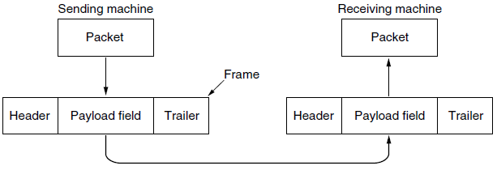
DATA LINK LAYER DESIGN ISSUES
Frame management forms the heart of what the data link layer does.

Slide 6
DATA LINK LAYER DESIGN ISSUES
1- Services Provided to the Network Layer
The function of the data link layer is to provide services to the network layer.
On the source machine is an entity, call it a process, in the network layer that hands some bits to the data link layer for transmission to the destination.
The job of the data link layer is to transmit the bits to the destination machine so they can be handed over to the network layer there

Slide 7
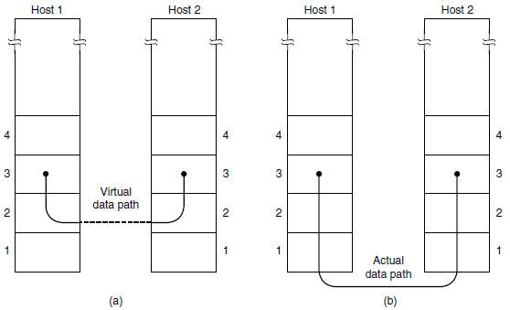
DATA LINK LAYER DESIGN ISSUES

Slide 8
DATA LINK LAYER DESIGN ISSUES
The data link layer can be designed to offer various services. The actual services that are offered vary from protocol to protocol. Three reasonable possibilities:
1- Unacknowledged connectionless service.
The source sends, the destination does not acknowledge them.
No logical connection.
If some frames are lost due to noise, recovery is up to the higher layers.
This service is suitable for voice transmission, links using highly reliable.

Slide 9
DATA LINK LAYER DESIGN ISSUES
2- Acknowledged connectionless service.
Each frame sent by the source Data Link Layer is individually acknowledged by the destination Data Link Layer.
If a frame has not reached the destination safely, it can be sent again.
No logical connection is made before or released after the exchange of data

Slide 10
DATA LINK LAYER DESIGN ISSUES
3- Acknowledged connection-oriented service.
The source and destination machines establish a connection before any data are transferred.
Each frame sent over the connection is number.
Guarantees that each frame sent is indeed received.
Guarantees that each frame is received exactly once.
All frames are received in the right order.
It is appropriate over long, unreliable links

Slide 11
DATA LINK LAYER DESIGN ISSUES
2- Framing
Data-link layer takes packets from Network Layer and encapsulates them into Frames.
Then, it sends each frame bit-by-bit on the hardware. At receiver end, data link layer picks up signals from hardware and assembles them into frames.
A good design must make it easy for a receiver to find the start of new frames while using little of the channel bandwidth.

Slide 12
DATA LINK LAYER DESIGN ISSUES
There are four methods:
A- Byte count
The first framing method uses a field in the header to specify the number of bytes in the frame.

Slide 13
DATA LINK LAYER DESIGN ISSUES
The trouble with this algorithm is that the count can be garbled by a transmission error.

Slide 14
DATA LINK LAYER DESIGN ISSUES
B- Flag bytes with byte stuffing
Each frame starts with special start and end bytes. Often the same byte, called a flag byte
Two consecutive flag bytes indicate the end of one frame and the start of the next.

Slide 15
DATA LINK LAYER DESIGN ISSUES
However, there is a still a problem we have to solve. It may happen that the flag byte occurs in the data.
This problem is to have the sender’s data link layer insert a special escape byte (ESC) just before each ‘‘accidental’’ flag byte in the data
This technique is called byte stuffing.

Slide 16
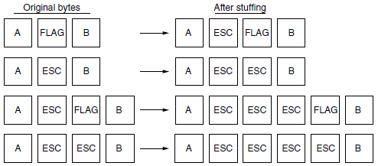
DATA LINK LAYER DESIGN ISSUES
what happens if an escape byte occurs in the middle of the data?

Slide 17
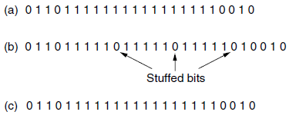
DATA LINK LAYER DESIGN ISSUES
C- Flag bits with bit stuffing
Each frame begins and ends with a special bit pattern, 01111110 or 0x7E in hexadecimal. This pattern is a flag byte.
Whenever the sender’s data link layer encounters five consecutive 1s in the data, it automatically stuffs a 0 bit into the outgoing bit stream.

Slide 18
DATA LINK LAYER DESIGN ISSUES

Slide 19
DATA LINK LAYER DESIGN ISSUES
Notes:
With both bit and byte stuffing, a side effect is that the length of a frame now depends on the contents of the data it carries.
Many data link protocols use a combination of these methods for safety. A common pattern used for Ethernet and 802.11 is to have a frame begin with a well-defined pattern called a preamble.
long (72 bits is typical for 802.11)
The preamble is then followed by a length (i.e., count) field in the header

Slide 20
DATA LINK LAYER DESIGN ISSUES
3- Error Control
How to make sure all frames are eventually delivered to the network layer at the destination and in the proper order.
For the connection oriented service, the data link layer must guarantee that all the frames sent arrive at the receiver in the proper order, and only one correct copy of each frame is expected at the receiver.
The receiver usually sends an acknowledgement (ACK) or a negative acknowledgement (NACK) back to the transmitter.
These ACKs and NACKs are typically very short in length and do not consume the channel capacity.

Slide 21
DATA LINK LAYER DESIGN ISSUES
To stop the loss of a frame or an ACK/NACK due to channel errors causing the transmitter to wait forever to transmit the next frame, a time out procedure is used. If after certain time, an ACK or NACK is not reached the transmitter, the frame is sent again.
However, if only the ACK is lost, the sender transmits a copy of the same frame causing duplication and waste of channel capacity.
By introducing sequence numbers to all frames, passing of a duplicate frame to the network layer can be prevented.

Slide 22
DATA LINK LAYER DESIGN ISSUES
4- Flow Control
What to do with a sender that systematically wants to transmit frames faster than the receiver can accept them.
This situation can occur when the sender is running on a fast, powerful computer and the receiver is running on a slow, low-end machine.
A common situation is when a smart phone requests a Web page from a far more powerful server.

Slide 23
DATA LINK LAYER DESIGN ISSUES
Clearly, something has to be done to prevent this situation. Two approaches are commonly used:
Feedback-based flow control, the receiver sends back information to the sender giving it permission to send more data, or at least telling the sender how the receiver is doing. (The link layer and higher layers)
Rate-based flow control, the protocol has a built-in mechanism that limits the rate at which senders may transmit data, without using feedback from the receiver. (Transport layer)

Slide 24
THANK YOU

